Slide 1
Data Analysis Using Excel
Karthik V

Slide 2
Fundamentals of Data Analysis
What is data analysis?
Data analysis is the process of inspecting, cleaning, transforming, and modeling data with the goal of discovering useful information, informing conclusions, and supporting decision-making.

Slide 3
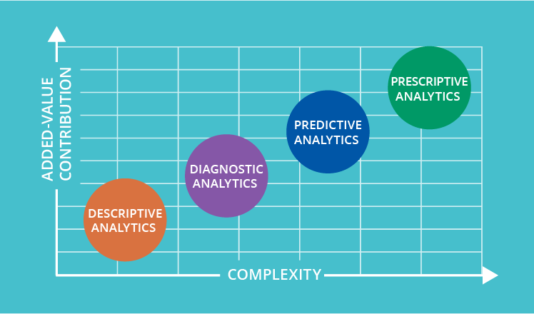
Types of data analysis

Slide 4
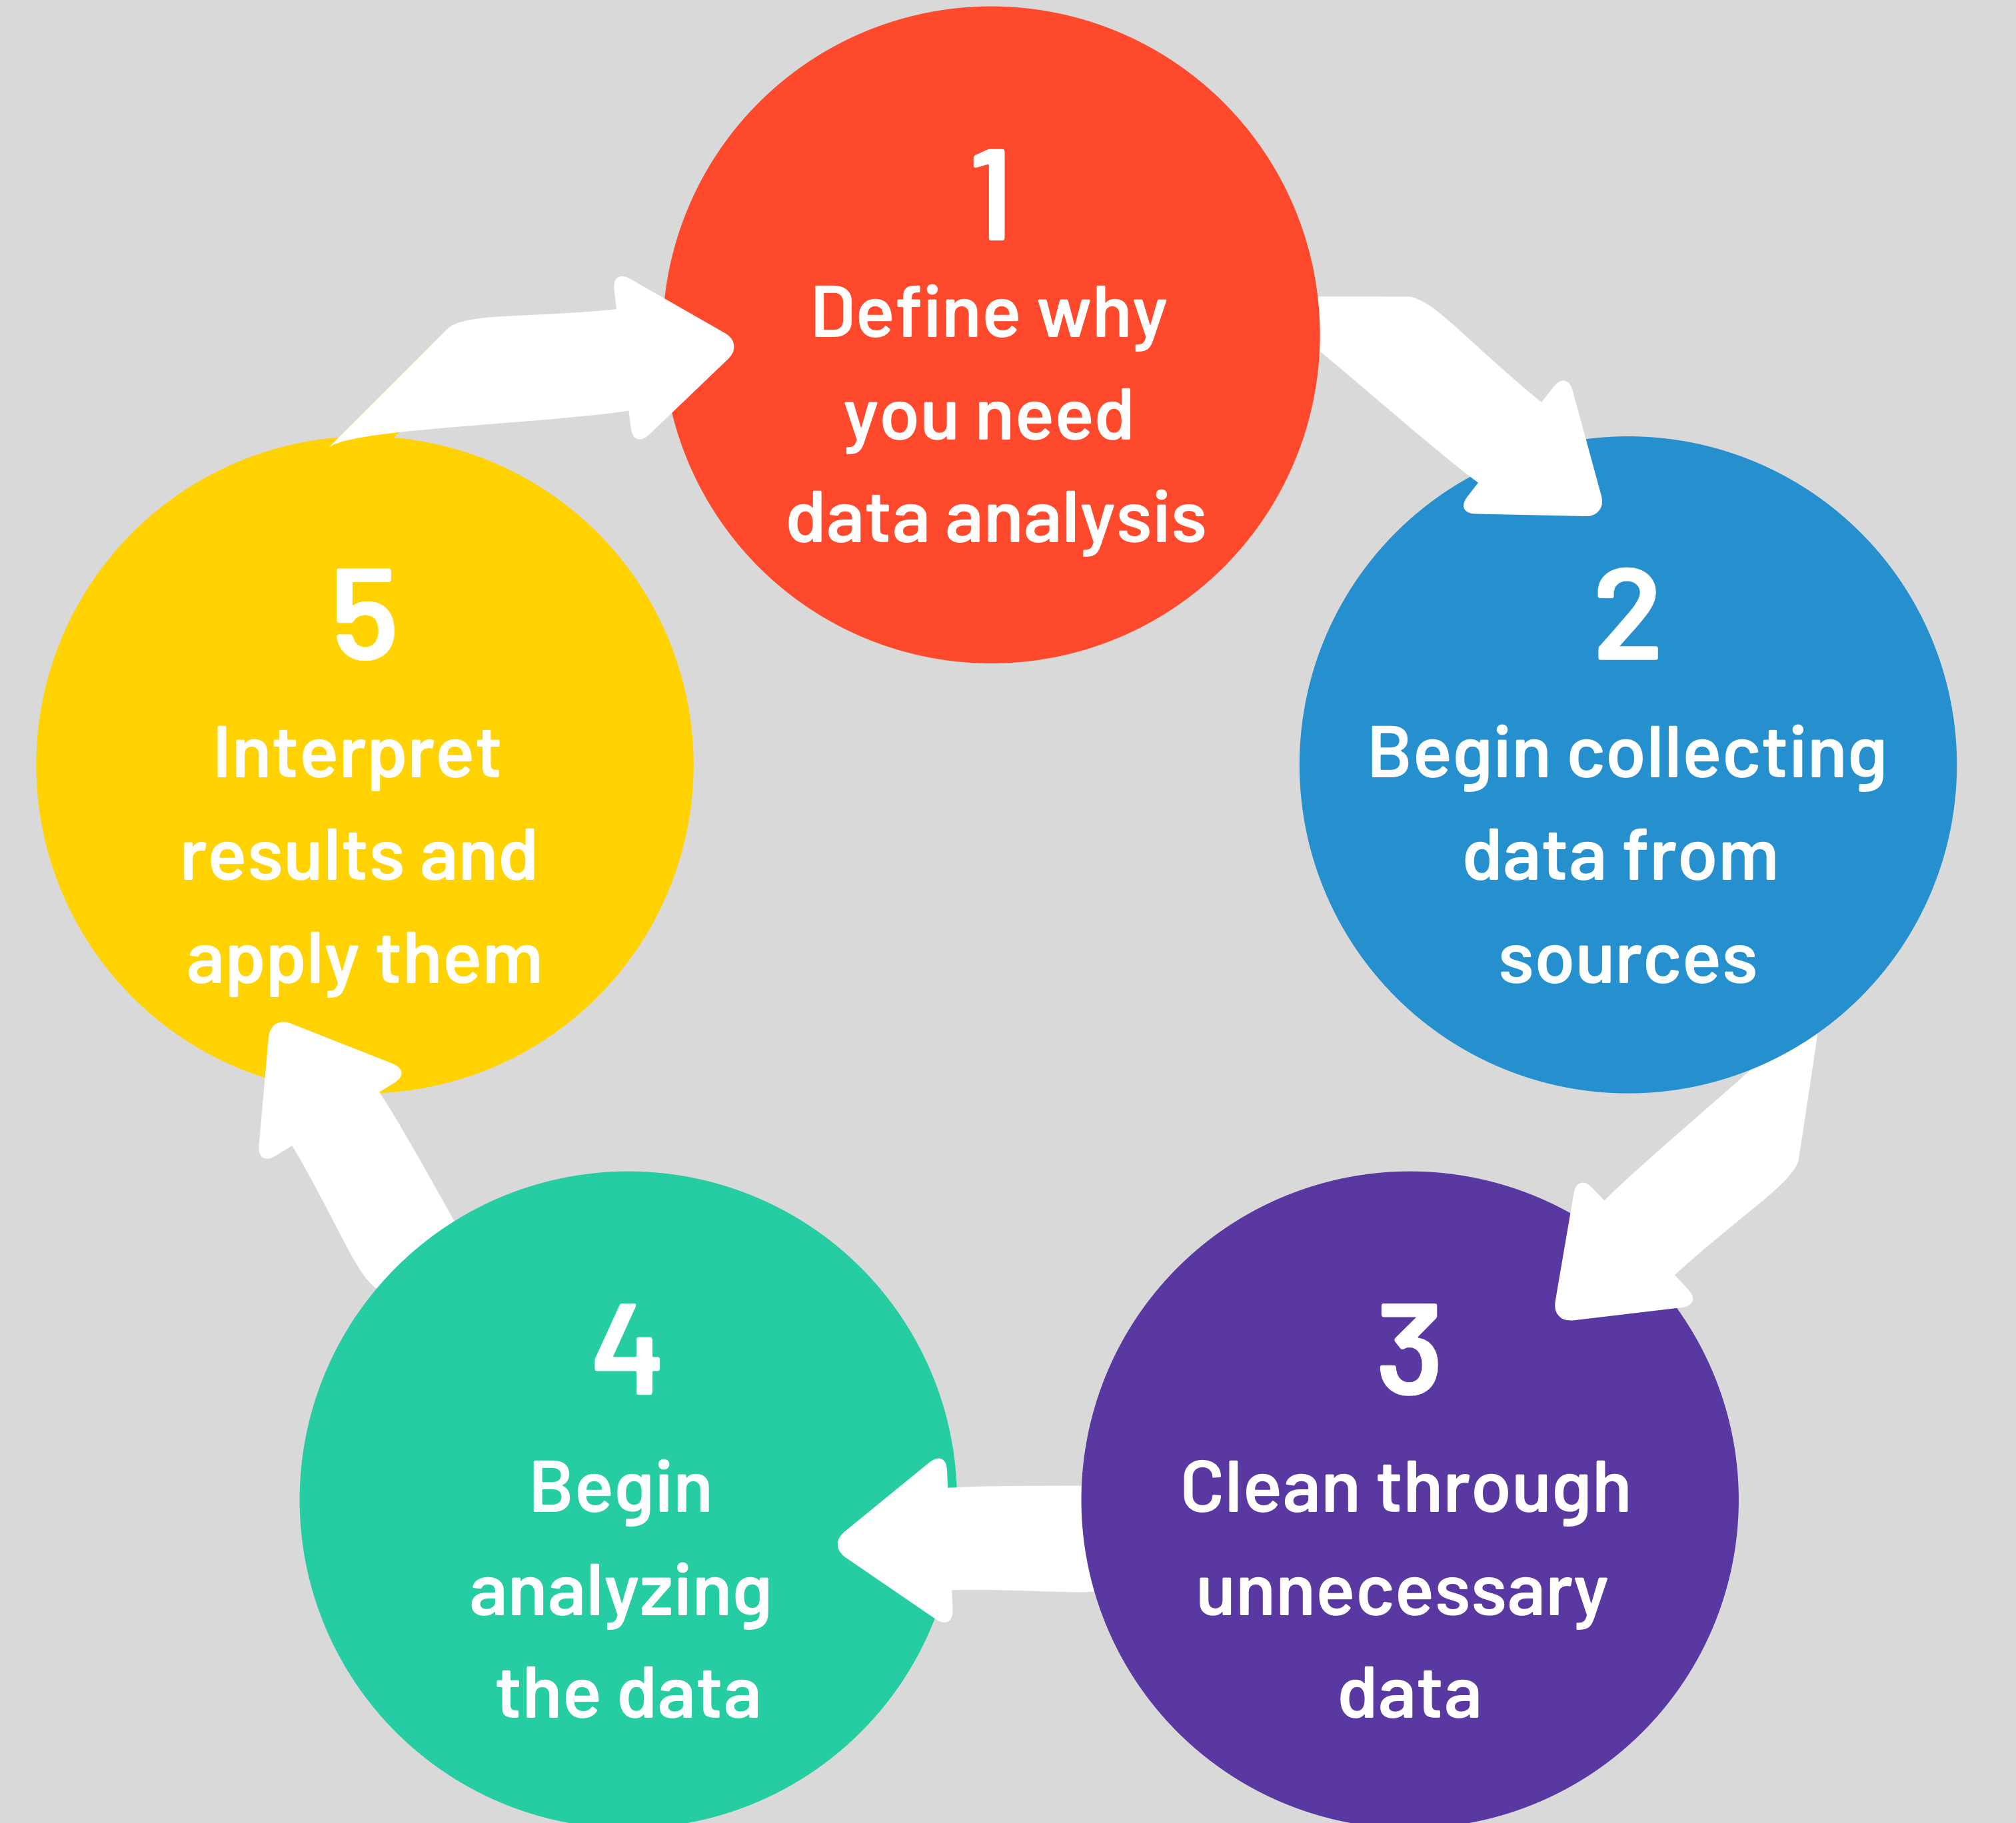
Data analysis steps

Slide 5
Tools and Technologies for Data Analytics
Spreadsheets: Spreadsheets are a simple and easy-to-use tool for data analysis. They can be used to store, organize, and manipulate data.
Statistical software: Statistical software is a more powerful tool for data analysis. It can be used to perform a variety of statistical tests and analyses. Ex: python, R, SAS, etc.
Machine learning software: Machine learning software is used to develop models that can learn from data and make predictions.
Data visualization software: Data visualization software is used to create charts, graphs, and other visuals that can help to communicate the results of data analysis.
Cloud computing: Cloud computing provides a scalable and cost-effective way to store and analyze data.
Big data technologies: Big data technologies are used to store and analyze large datasets.
Internet of Things (IoT): IoT technologies are used to collect data from devices and sensors.

Slide 6
Introduction to Excel
Excel is a spreadsheet program that is used to store, organize, and analyze data.
Excel is a powerful tool that can be used for a variety of tasks, such as:
Data entry and management
Data cleaning and preparation
Statistical analysis
Data visualization

Slide 7
Excel Tips to Save Time
Use keyboard shortcuts
Use formulas
Use conditional formatting
Use data validation
Use macros
Use templates
Use the help feature

Slide 8
Excel Formulas for Quick and Dynamic Analysis
SUM
AVERAGE
COUNT
MAX
MIN
IF
VLOOKUP
HLOOKUP
SUMIF
COUNTIF

Slide 9
SUMIFS:
Sum values based on multiple criteria.
Useful for analyzing data that meets specific conditions
AVERAGEIFS:
Calculate the average of values that meet specified criteria.
Enables analysis of data subsets based on conditions.
COUNTIFS:
Count the number of cells that meet multiple criteria.
Allows for counting specific occurrences in data.
VLOOKUP:
Retrieve data from a table based on a lookup value.
Useful for finding matching values in different datasets.

